Slide 1
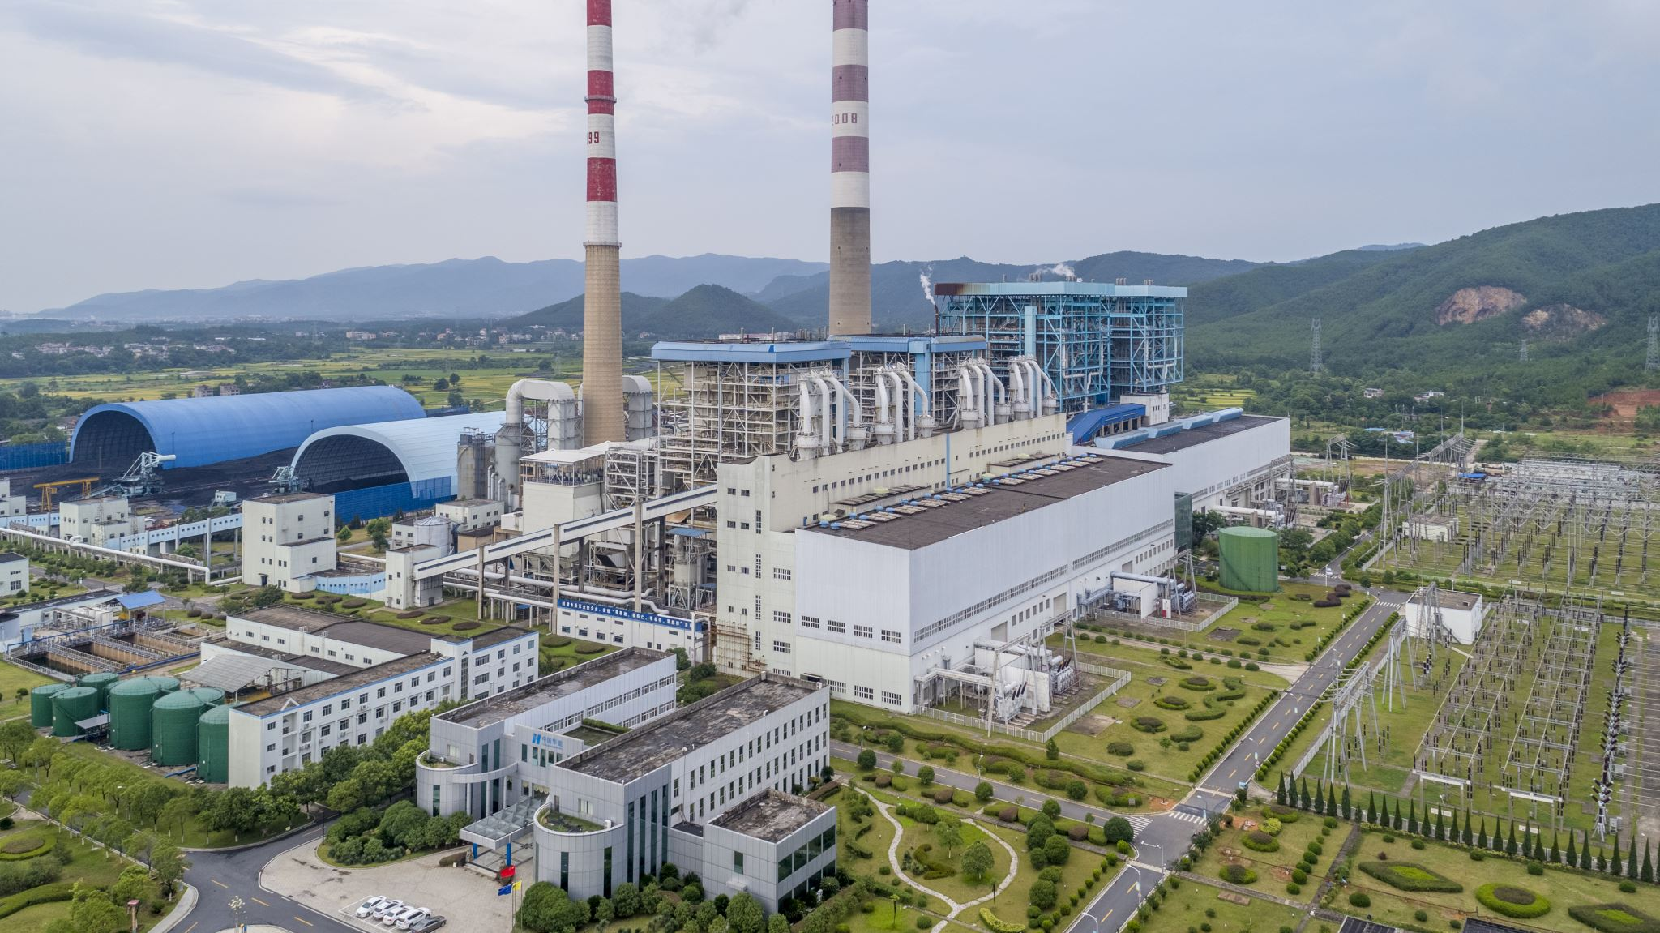
Power Quality in electrical distribution systems and buildings

Slide 2

Agenda
What Power Quality means
Key parameters and typical disturbances
Why it matters for engineers
Standards, measurement and mitigation
Power Quality in buildings
Country comparison: Finland - Bangladesh - Austria
Conclusions

Slide 3
Main ideas
Reliable delivery to homes, buildings and industries with the:
  Right voltage - magnitude, dips, swells, interruptions
  Right frequency - balance between generation and load
  Consideration of harmonic distortion
Power Quality = quality of voltage + continuity of supply
Higher sensitivity of modern devices (electronics, drives, IT)
Utility and customer share the responsibility: emission vs. immunity

Slide 4

What is Power Quality?
Ideal supply: pure sine wave, constant amplitude, constant 50 Hz, symmetrical
Real supply deviates - Power Quality describes how far
Voltage parameters (EN 50160)
  Magnitude: 230 V, +/-10 % for 95 % of the weekly 10-min values
  Frequency: 50 Hz +/-1 % for 99,5 % of the year
  Harmonics: THD of the voltage <= 8 %
  Unbalance: negative sequence <= 2 %
  Flicker: long-term severity Plt <= 1
Continuity: number and duration of interruptions (SAIDI / SAIFI)

Slide 5
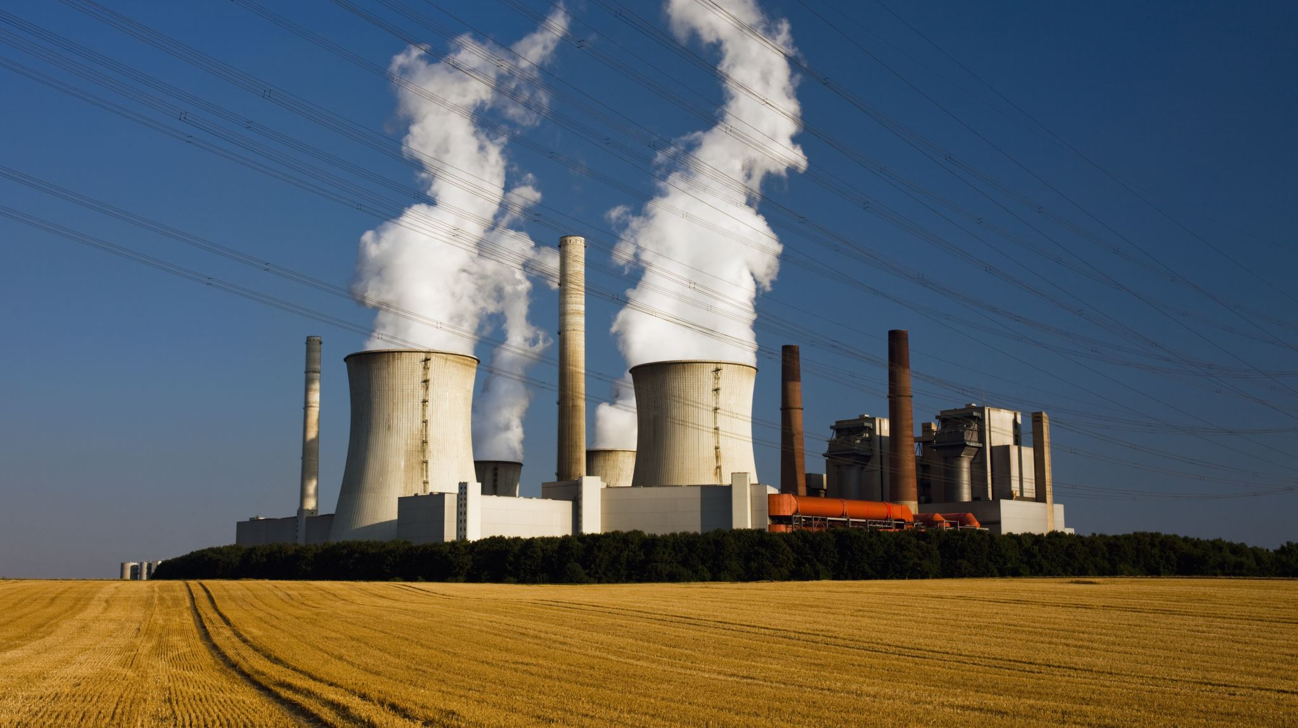
Typical disturbances - causes and effects
Voltage dip / sag - short circuits, motor starting -> drives and PLCs trip
Swell / overvoltage - load rejection, PV feed-in, switching -> insulation stress
Interruption - faults, protection operation -> production stop
Harmonics - rectifiers, LED drivers, inverters -> losses, hot neutral conductor
Unbalance - unequal single-phase loads -> extra losses, motor heating
Flicker - welding machines, arc furnaces -> visible light fluctuation
Transients - lightning, switching operations -> destroyed electronics

Slide 6
Relevance for engineering professionals
Reliability - fewer trips, less unplanned downtime
Safety
  Overvoltage caused by photovoltaic systems
  The system changes from mono-directional to bi-directional
Energy efficiency
  With unbalanced phases additional energy losses are expected
  Harmonic currents increase transformer and cable losses
Asset lifetime - thermal stress shortens the life of cables, motors, capacitors
Legal duty - grid codes and connection rules must be fulfilled

Slide 7
Examples of professional situations
Designing power plants
Designing of substations
Compliance with the standards
Choosing the right voltage for transmission
Choosing the right transmission type (overhead lines or buried cables)
Grid connection studies for PV plants, EV chargers and large drives
Troubleshooting: measuring campaign after repeated equipment failures

Slide 8
Power Quality in buildings
Modern buildings are dominated by electronic loads
  LED lighting, PCs and servers, heat pumps, EV chargers, PV inverters
Single-phase rectifiers produce a strong 3rd harmonic
  Triplen harmonics add up in the neutral conductor
  Neutral current can exceed the phase current -> fire risk
Counter-measures start in the design phase
  Full-size or oversized neutral conductor, TN-S system, short supply cables
  Balanced distribution of single-phase loads over L1 / L2 / L3

Slide 9
Economic impact
Costs of poor Power Quality are mostly hidden
  Production downtime, scrap, restart times
  Additional losses in cables and transformers
  Reduced lifetime of equipment, higher maintenance
European studies estimate losses in industry in the range of billions of euros per year
A single voltage dip in a semiconductor fab can cost six-digit amounts
Filters and monitoring are cheap compared to one lost production day

Slide 10

Similarities and differences in different countries
Finland
high standards in terms of quality
77 Distribution Companies
22 – 23 cents per kWh
Bangladesh
Lower standards in terms of quality
6 Distribution Companies
3,5 - 10 cents per kWh
Austria
high standards in terms of quality
115 Distribution Companies
21 – 29 cents per kWh
Similarities
Voltage and Frequency

